Slide 1
Health Reminder App
Java FS with Node + React DH batch Jan 28th
By-
46055642 Naman Bhandari(TL)
46055640 Parth Goel
46055645 Shania Vijay Dalal
46055646 Sayantan Das
46055782 Ankit Banerjee

Slide 2
Problem Statement/Case Study:
Business Requirement - to improve user’s health by reminding them to do specific tasks during the day and stick to their personal health improvement goals.
The 1st priority of our development will be to help patients set reminder for their medications and improvement goals.
Other features that might get added include:
Adding tips for users with various health conditions.
Keeping medical records for the Doctor to see
Text message communication between Patient and Doctor
Fitness and Weight Loss Tracker

Slide 3
Actors:
Admin: Add/Delete Additional tips for users with various health conditions, Approve or Reject doctors on verification, Ensuring smooth retrievals of Reports and History, create notification alarms,etc.
2. Doctors: Doctors can view or reply to the questions asked by patients, appointment schedules, set appointments, etc.
3. Patients: Patients can set reminders for their daily dosages or schedule their daily exercises and timely taking medicines, can view Doctors and make appointments, ask questions to the Doctors for immediate info, read daily tips on their health conditions and diseases,diet tracker, etc.

Slide 4
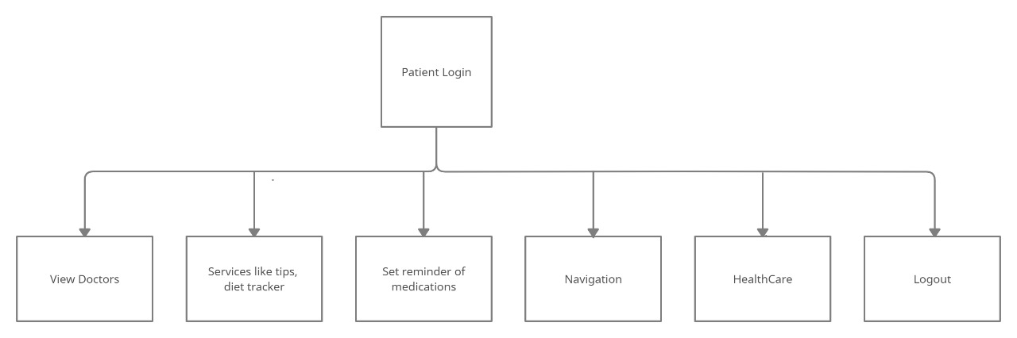
Services and Modules - Patient Modules
In addition to these modules, we will try to provide features of setting of Goals for fitness purpose etc.

Slide 5
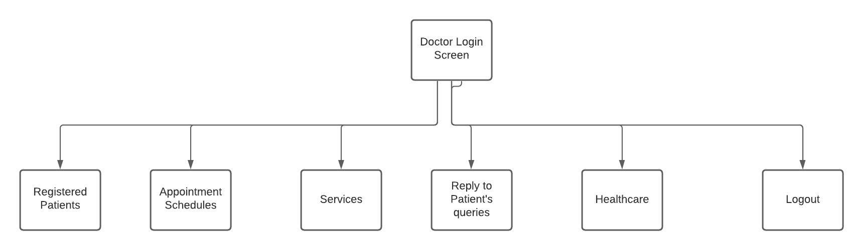
Services and Modules - Doctor Modules
The Doctor can view all the patients registered to him with all of his details.
The doctor can view the appointment schedule and can set the new appointments accordingly. This module will help in making proper adjustments.
The reply mode module allows the patient to ask some questions related to the prescribed pills, medicine schedules and other queries. The doctors can reply in yes or no mode.

Slide 6
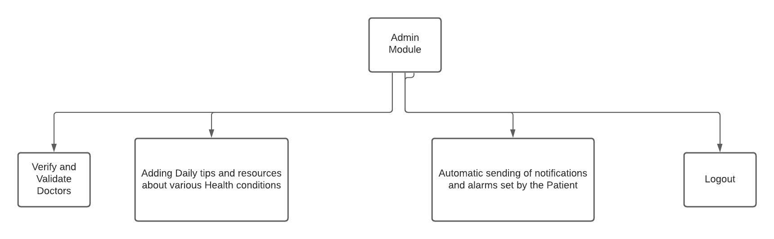
Services and Modules - Admin Module

Slide 7
Main Requirements to be Implemented as of now:
1. Set Reminder for medication: The user enters medicine name, day and time of the week, Admin sends notification and sets alarm accordingly.
2. Mental Health tips: On clicking, the user will be asked to enter a rating based on their mood. Based on rating, mental health tips will be displayed.
3. View Doctors for appointment & storing medical history:
For Doctors: The user can look for doctors and their free slots and can book appointment. On confirming appointment, we provide the contact details or a meeting link is scheduled.
For medical history: We allow the user to store any type of medical reports in any format for future references and easy accesss.
4. Detailed Disease info: As of now, create a Database with few diseases and disorders and show it as a dummy prototype, when the user searches for.
5. Diet tracker: As of now, Admin creates a database prototype on BMI based Diet plans to be displayed based on BMI input by the User.

Slide 8
Diagrams/Design Docs

Slide 9
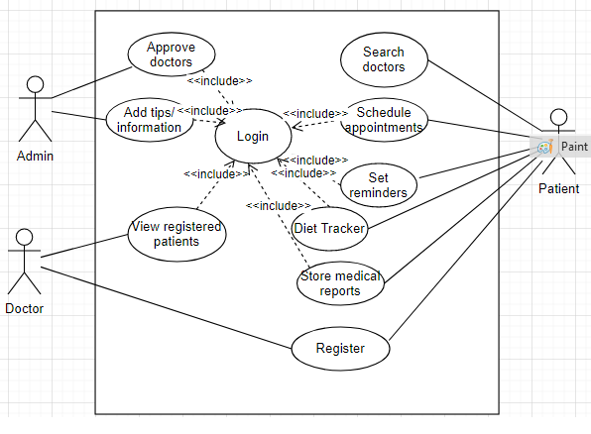
Use – Case Diagram

Slide 10
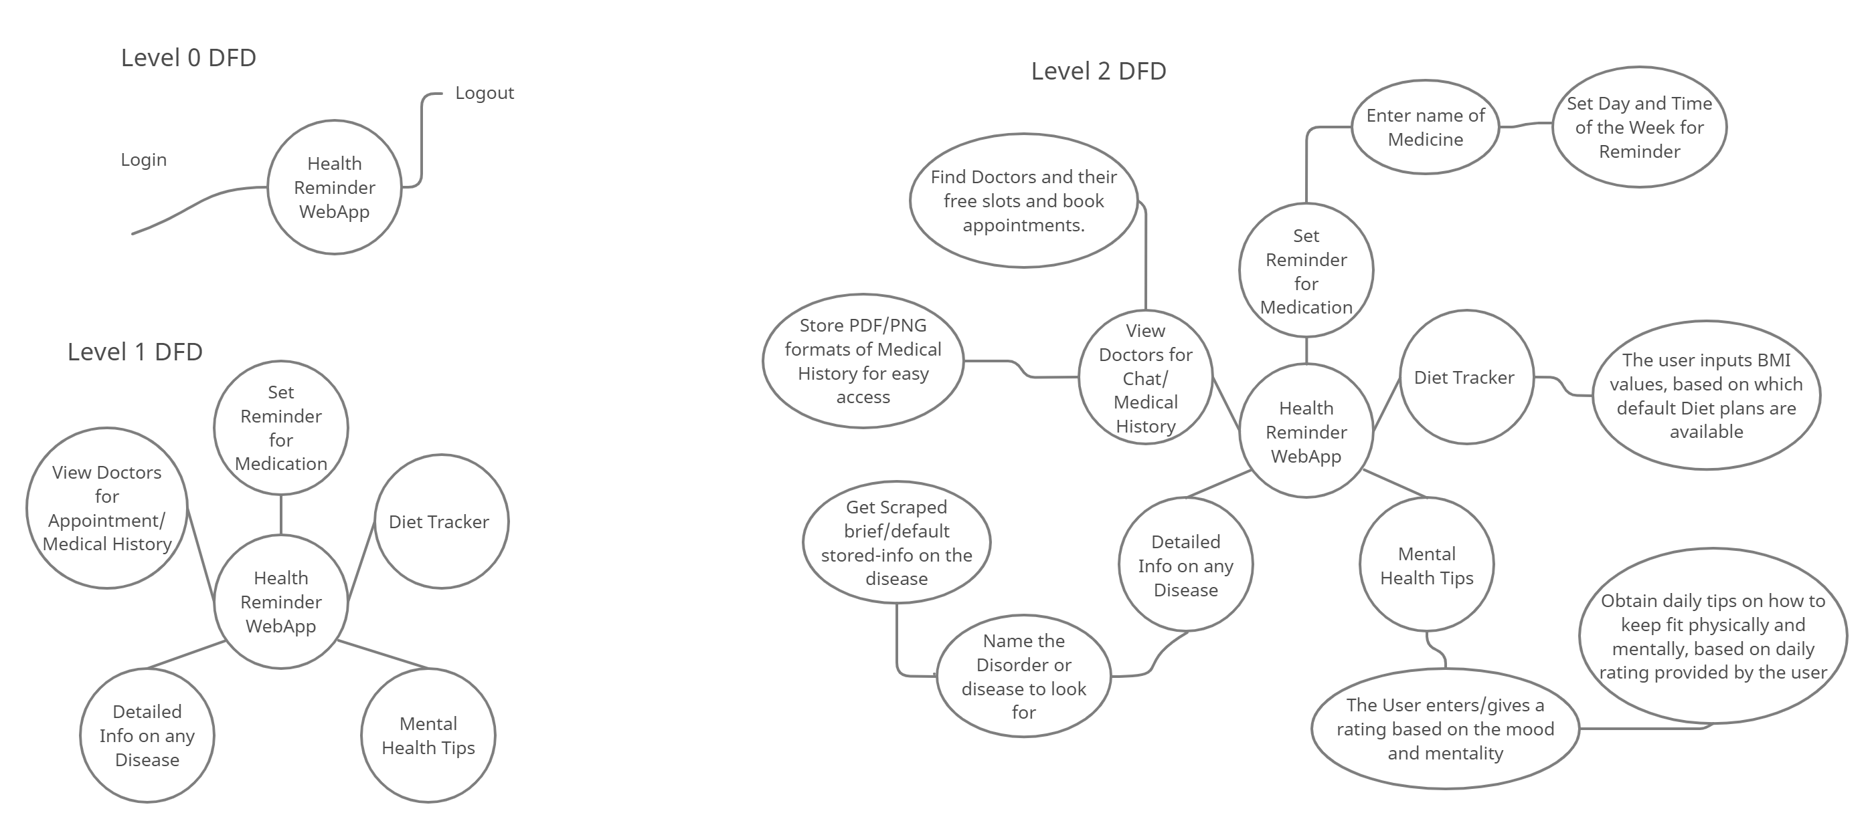
Data Flow Diagram

Slide 11
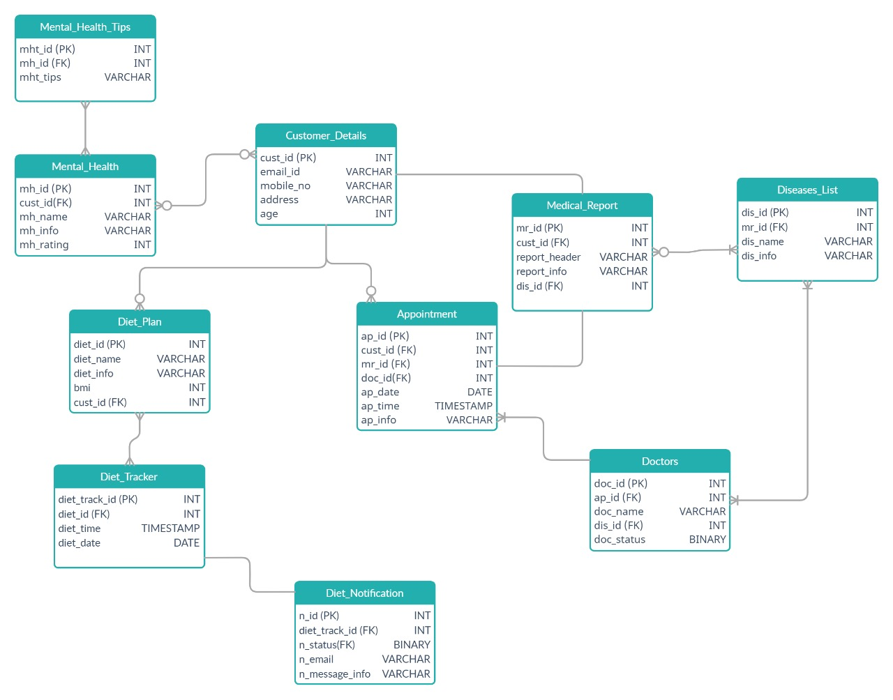
ER Diagram

Slide 12
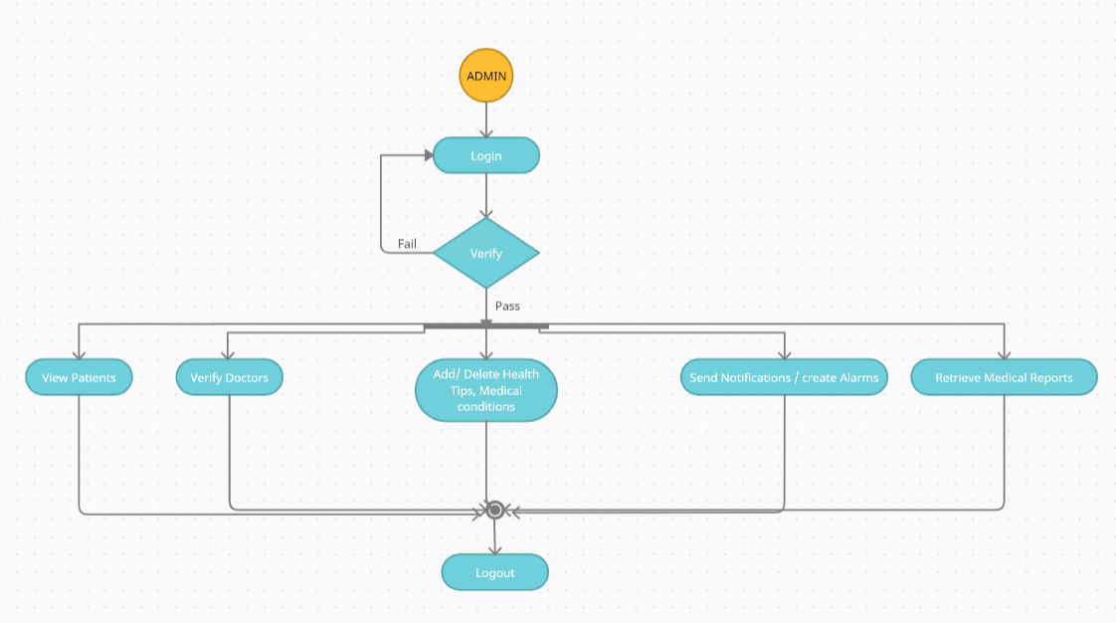
Activity Diagram - Admin

Slide 13
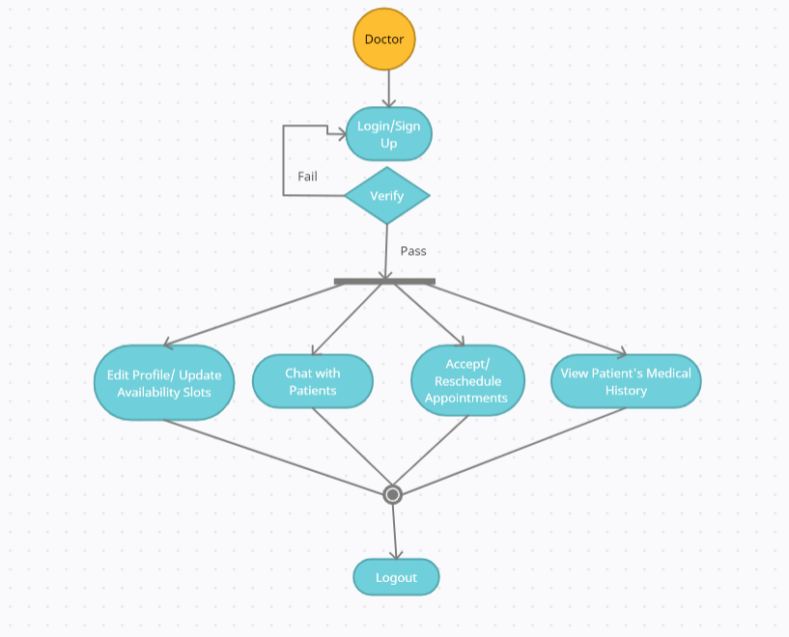
Activity Diagram - Doctor

Slide 14
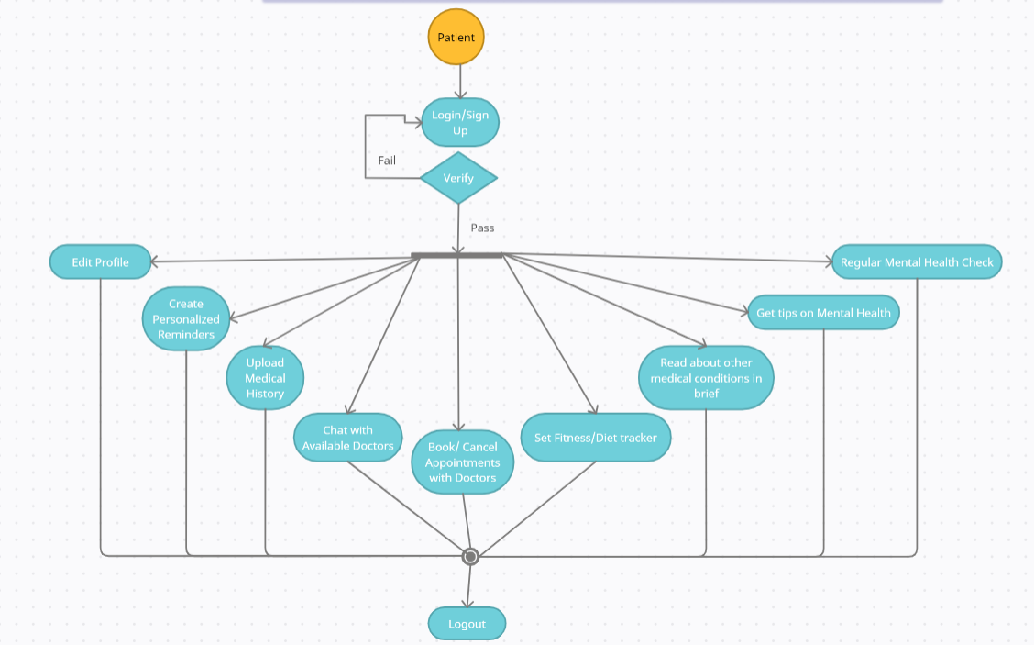
Activity Diagram -Patient

Slide 15
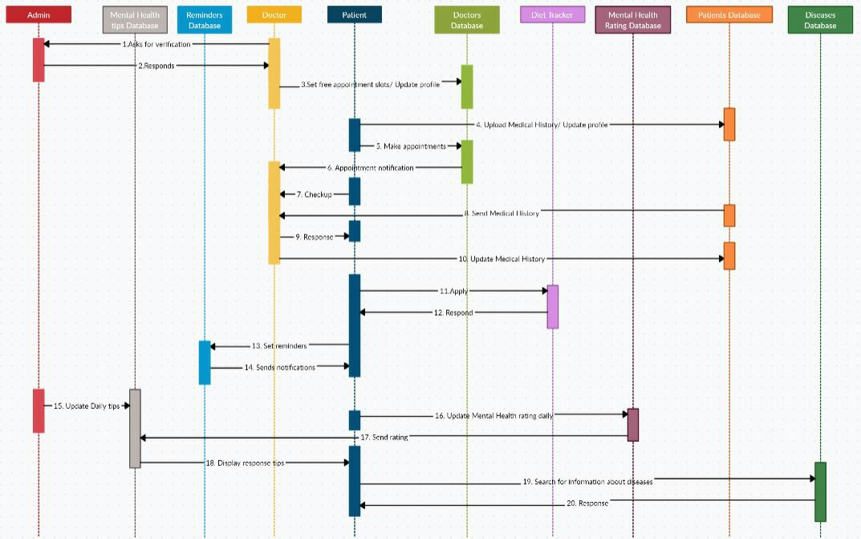
Sequence Diagram

